Slide 1
DEVJAM 2023
Team Falcons
Presentation

Slide 2
Mrinal Varshney
(20223156)
Team Members
Ish Singhal
(20223115)
Shivansh Mishra
(20223249)
Vishal Patel
(20223314)

Slide 3

Idea/Problem
Most of the times when the class commence students often forgets to silent their phones. When phones suddenly rang up result in disturbing the decorum of class and is also can cause distraction to student as well as teacher.

Slide 4
Solution
Our team created an app named set-OFF. It automatically silent user’s phone when the class commence and make alerts audible after class gets over.

Slide 5
Tech stack Android app development
Android Studio
It has a flexible Gradle-based build system.
It has a fast and feature-rich emulator for app testing.
Android Studio has a consolidated environment where we can develop for all Android devices.
Apply changes to the resource code of our running app without restarting the app.
Android Studio provides extensive testing tools and frameworks.
VS Code
Supports for debugging, syntax highlighting, intelligent code completion, snippets, code refactoring, and embedded Git.

Slide 6

FrameWork Used
React Native
To design this app our team used a framework named react native. As React native provides slick ,smooth and responsive user interface, while significantly reducing load time. Our team used react native because when we develop same technology for ios and other platforms we don’t have to write code another time for same app with same functionality we can take use of the same code.

Slide 7

For the database storage of this app our team used SQLite database tech because
SQLite is very lightweight and can give up to 35% faster performance than other file systems.
It saves the data in the local storage of our device
,so that our app will be able to function even when
the device is offline.

Slide 8
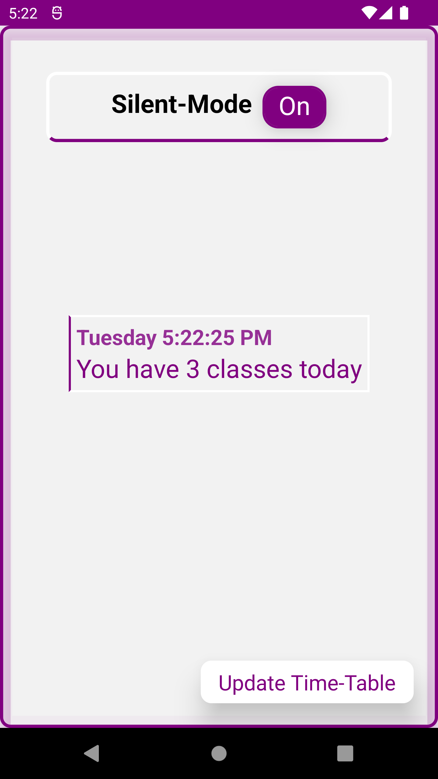
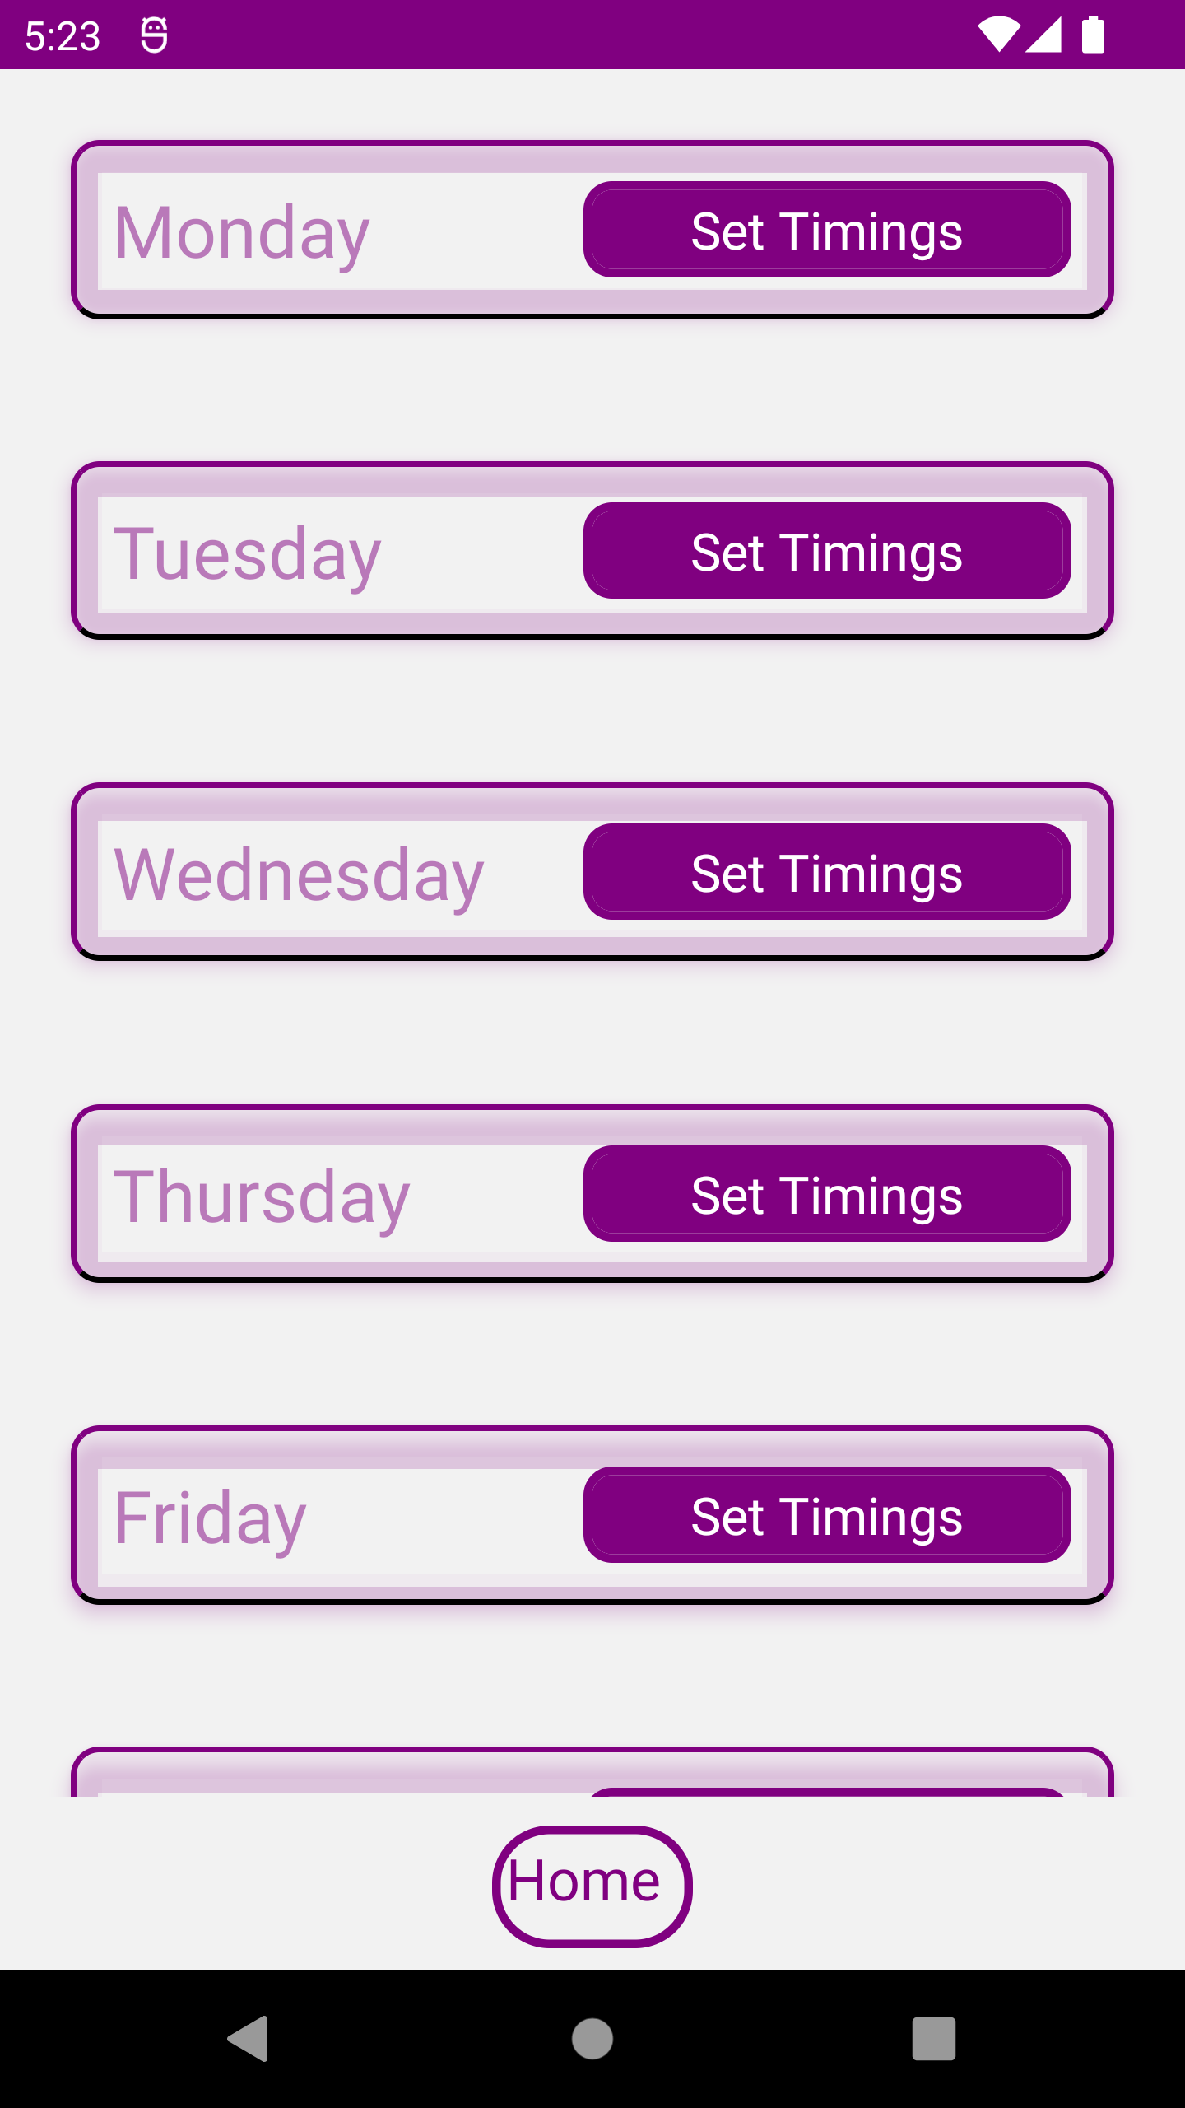
You can easily update your time slots. Just click on the bottom right icon ( update time table).

Slide 9
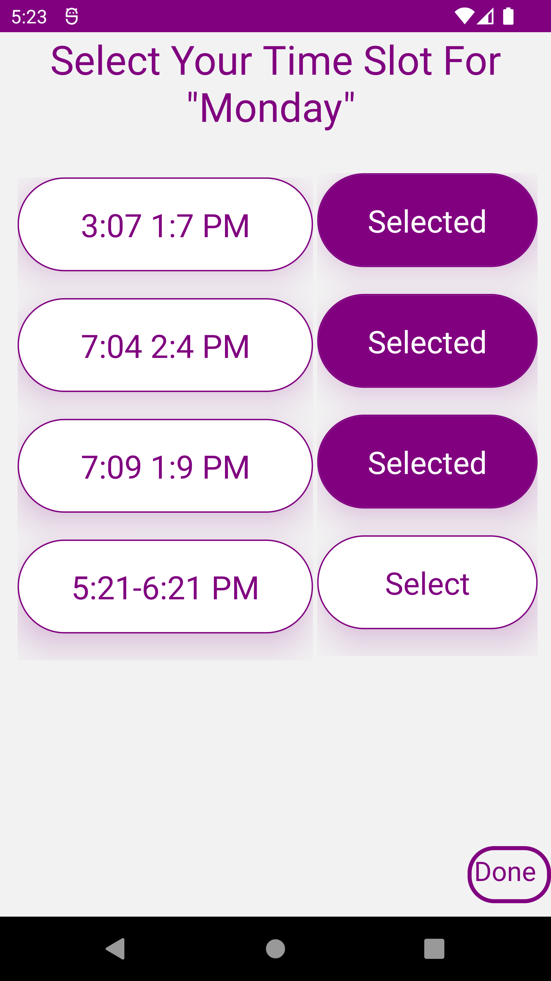
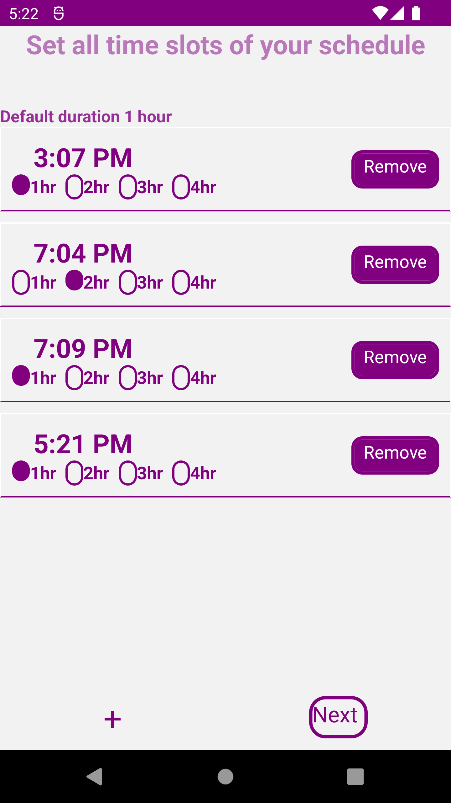
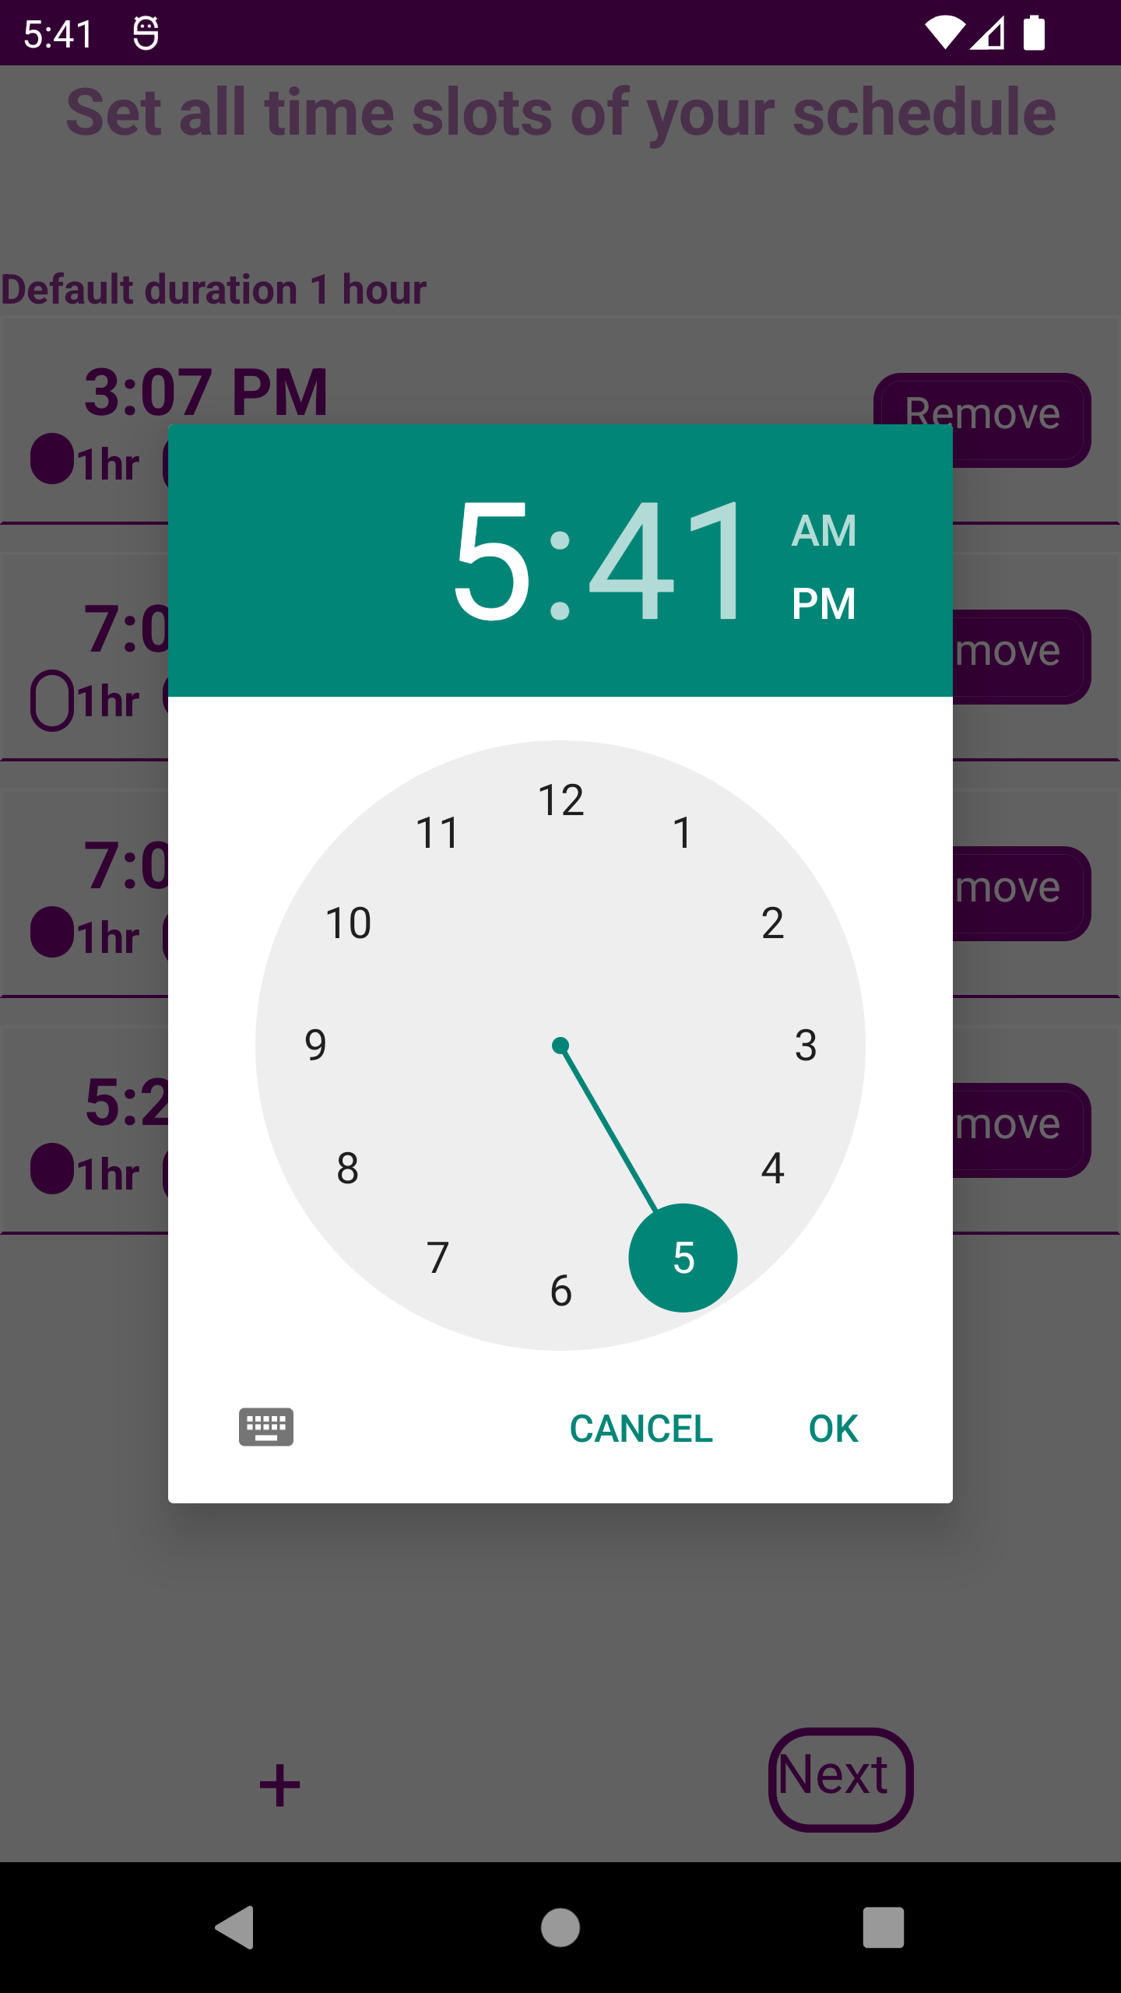
Instructions
Add time slots in the apps according to schedule of college for different days of the week

Slide 10
THANK YOU : )
Mrinal Varshney
Ish Singhal
Vishal Patel
Shivansh Mishra

